Slide 1

Madiga Venugopal
Final Project
3/21/2024 Annual Review

Slide 2
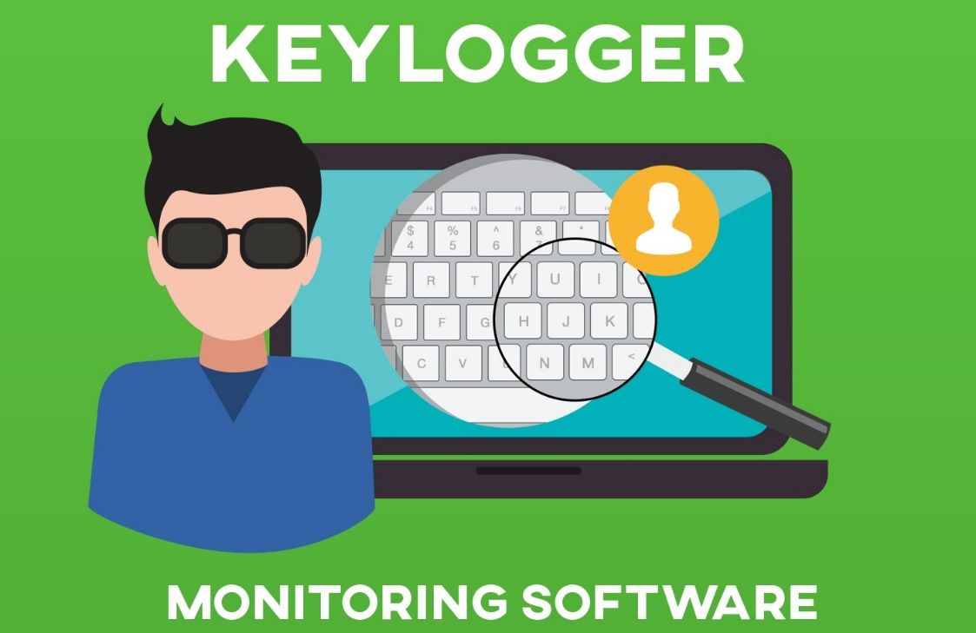
KEYLOGGER AND SECURITY
Understanding and take Security about the Keylogger
3/21/2024 Annual Review

Slide 3


AGENDA
→ INTRODUCTION
→ PROBLEM STATEṀĒNT
→ PROBLEM OVERVIEW
→ END USERS
→ SOLUTION AND VALUE PROPOSITION
→ MY SOLUTION
→ MODELLING
→ RESULT
3/21/2024 Annual Review

Slide 4
INTRODUCTION
A keylogger is a form of malware or hardware that keeps track of and records your keystrokes as you type. It takes the information and sends it to a hacker using a command-and-control (C&C) server.
Keyloggers, or keystroke loggers, are tools that record what a person types on a device. While there are legitimate and legal uses for keyloggers, many uses for keyloggers are malicious. In a keylogger attack, the keylogger software records every keystroke on the victim's device and sends it to the attacker

Slide 5

PROBLEM STATEMENT
The problem statement is that the keyloggers can be detected using antiviruses. Installation of hardware keyloggers is difficult without the knowledge of the owner of the system. The solution to the above existing problem is that we can build a software keyloggers instead of hardware keyloggers.
3/21/2024 Annual Review

Slide 6

PROJECT OVERVIEW
A keylogger, sometimes called a keystroke logger, is a type of surveillance technology used to monitor and record each keystroke on a specific device, such as a computer or smartphone. It can be either hardware- or software-based. The latter type is also known as system monitoring software or keyboard capture software.
3/21/2024 Annual Review

Slide 7

WHO ARE THE END USERS?
END USERS
An end user is a person or other entity that consumes or makes use of the goods or services produced by businesses. In this way, an end user may differ from a customer—since the entity or person that buys a product or service may not be the one who actually uses it.
There are different types of end users. They can be individuals, entrepreneurs, or companies. Graphic designers create company logos, websites, graphics, and layouts for product installations by using laptops and other additional devices of their employers
3/21/2024 Annual Review

Slide 8

YOUR SOLUTION AND ITS VALUE PROPOSITION
SOLUTION TO KEYLOGGER
Keylogging hardware can usually be removed by unplugging or removing the physical device. The good news is that there are ways to tell if there's a keylogger on your computer — in fact, some of the best free antivirus software options can function as anti-keylogger software too.
What are the benefits of using anti-keylogging software? Using anti-keylogging software can help prevent identity theft and cyber attacks that involve the theft of sensitive information. It can also protect personal data, login credentials, and credit card information from being stolen by keylogging malware.
3/21/2024 Annual Review

Slide 9

THE WOW IN YOUR SOLUTION
Innovative Approach: Combining technical measures with
user education for comprehensive protection.
Demonstration: Real-time demonstration of a simple keylogger
to illustrate the threat and the effectiveness of security measures.
Impact: Significant reduction in the likelihood of keylogging attacks
through proactive measures.
3/21/2024 Annual Review
9

Slide 10
MODELLING
Teams cam add wireframes
Architecture Overview:
Modular Design: The keylogger code is structured into modular functions for better readability and maintenance.
Event Handling: Utilizes the pynput library to capture and handle keyboard events.
Data Logging: Implements functions to log captured data into text and JSON files.
3/21/2024 Annual Review
10

Slide 11
RESULTS
[{"Pressed": "'h'"}, {"Held": "'h'"}, {"Released": "'h'"}, {"Pressed": "'o'"}, {"Held": "'o'"}, {"Released": "'o'"}, {"Pressed": "'l'"}, {"Held": "'l'"}, {"Released": "'l'"}, {"Pressed": "'l'"}, {"Held": "'l'"}, {"Released": "'l'"}, {"Pressed": "'y'"}, {"Held": "'y'"}, {"Released": "'y'"}, {"Pressed": "'w'"}, {"Held": "'w'"}, {"Released": "'w'"}, {"Pressed": "'o'"}, {"Held": "'o'"}, {"Released": "'o'"}, {"Pressed": "'o'"}, {"Held": "'o'"}, {"Released": "'o'"}, {"Pressed": "'d'"}, {"Held": "'d'"}, {"Released": "'d'"}, {"Pressed": "Key.space"}, {"Held": "Key.space"}, {"Released": "Key.space"}, {"Pressed": "'t'"}, {"Held": "'t'"}, {"Released": "'t'"}, {"Pressed": "'h'"}, {"Held": "'h'"}, {"Released": "'h'"}, {"Pressed": "'e'"}, {"Held": "'e'"}, {"Held": "Key.space"}, {"Released": "'e'"}, {"Released": "Key.space"}, {"Pressed": "'m'"}, {"Held": "'m'"}, {"Released": "'m'"}, {"Pressed": "'o'"}, {"Held": "'o'"}, {"Released": "'o'"}, {"Pressed": "'v'"}, {"Held": "'v'"}, {"Released": "'v'"}, {"Pressed": "'i'"}, {"Held": "'i'"}, {"Released": "'i'"}, {"Pressed": "'e'"}, {"Held": "'e'"}, {"Released": "'e'"}, {"Pressed": "Key.space"}, {"Held": "Key.space"}, {"Released": "Key.space"}]
3/21/2024 Annual Review
11

